Slide 1
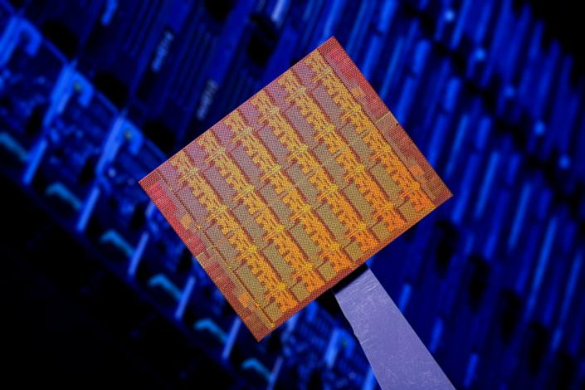
“Single-chip Cloud Computer”
An experimental many-core processor from Intel Labs
Jim Held
Intel Fellow & Director
Tera-scale Computing Research
Intel Labs Single-chip Cloud Computer Symposium
December, 2010

Slide 2
Agenda
09:00 Welcome and Opening Remarks
09:15 Jesse: Keynote Speech
09:45 Jim Held: Keynote Speech
10:45 Break
11:00 SCC Hardware Architecture Overview
11:50 Lunch – Informal discussions & SCC Demo
13:30 Today’s SCC Software Environment
14:10 Message Passing on the SCC
14:50 Software-Managed Coherency
15:30 Break
15:50 Application ”Deep Dive”
16:20 Many-core Applications Research Community
16:40 Experience Sharing
17:10 Q&A
17:30 Adjourn

Slide 3
Agenda
09:00 Welcome and Opening Remarks
09:15 Jesse: Keynote Speech
09:45 Jim Held: Keynote Speech
10:45 Break
11:00 SCC Hardware Architecture Overview
11:50 Lunch – Informal discussions & SCC Demo
13:30 Today’s SCC Software Environment
14:10 Message Passing on the SCC
14:50 Software-Managed Coherency
15:30 Break
15:50 Application ”Deep Dive”
16:20 Many-core Applications Research Community
16:40 Experience Sharing
17:10 Q&A
17:30 Adjourn

Slide 4
Agenda
09:00 Welcome and Opening Remarks
09:15 Jesse: Keynote Speech
09:45 Jim Held: Keynote Speech
10:45 Break
11:00 SCC Hardware Architecture Overview
11:50 Lunch – Informal discussions & SCC Demo
13:30 Today’s SCC Software Environment
14:10 Message Passing on the SCC
14:50 Software-Managed Coherency
15:30 Break
15:50 Application ”Deep Dive”
16:20 Many-core Applications Research Community
16:40 Experience Sharing
17:10 Q&A
17:30 Adjourn

Slide 5
Agenda
09:00 Welcome and Opening Remarks
09:15 Jesse: Keynote Speech
09:45 Jim Held: Keynote Speech
10:45 Break
11:00 SCC Hardware Architecture Overview
11:50 Lunch – Informal discussions & SCC Demo
13:30 Today’s SCC Software Environment
14:10 Message Passing on the SCC
14:50 Software-Managed Coherency
15:30 Break
15:50 Application ”Deep Dive”
16:20 Many-core Applications Research Community
16:40 Experience Sharing
17:10 Q&A
17:30 Adjourn

Slide 6
Agenda
09:00 Welcome and Opening Remarks
09:15 Jesse: Keynote Speech
09:45 Jim Held: Keynote Speech
10:45 Break
11:00 SCC Hardware Architecture Overview
11:50 Lunch – Informal discussions & SCC Demo
13:30 Today’s SCC Software Environment
14:10 Message Passing on the SCC
14:50 Software-Managed Coherency
15:30 Break
15:50 Application ”Deep Dive”
16:20 Many-core Applications Research Community
16:40 Experience Sharing
17:10 Q&A
17:30 Adjourn

Slide 7
Agenda
09:00 Welcome and Opening Remarks
09:15 Jesse: Keynote Speech
09:45 Jim Held: Keynote Speech
10:45 Break
11:00 SCC Hardware Architecture Overview
11:50 Lunch – Informal discussions & SCC Demo
13:30 Today’s SCC Software Environment
14:10 Message Passing on the SCC
14:50 Software-Managed Coherency
15:30 Break
15:50 Application ”Deep Dive”
16:20 Many-core Applications Research Community
16:40 Experience Sharing
17:10 Q&A
17:30 Adjourn

Slide 8
“Single-chip Cloud Computer”
An experimental many-core processor from Intel Labs
Jim Held
Intel Fellow & Director
Tera-scale Computing Research
ICCPC SCC Symposium
December 2010

Slide 9
Agenda
Tera-scale Research
Teraflops Research Processor
Single-chip Cloud Computer
Manycore Applications Research Community
Summary

Slide 10







What is Tera-scale?
TIPs of compute power operating on Tera-bytes of data
Entertainment
TIPS
Source: electronic visualization lab University of Illinois
Learning & Travel
RMS
Personal Media Creation and Management
GIPS
Performance
3D &
Video
Tera-scale
MIPS
Mult-
Media
Multi-core
KIPS
Text
Single-core
Health
Kilobytes
Megabytes
Gigabytes
Terabytes
Dataset Size
http://techresearch.intel.com/articles/Tera-Scale/1421.htm
Notes:
High performance computing is moving to the mainstream.
Becoming more visual, more immersive – processing increasing volume of data
Many involving simulation

Slide 11



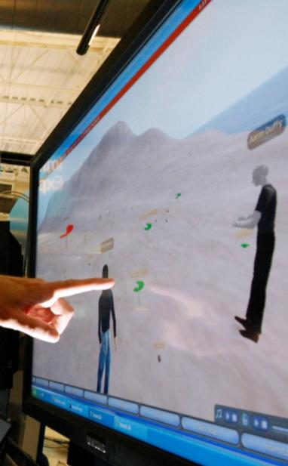
Performance Scaling Challenges
Energy
Efficiency
Design
Complexity
Programming
Models
Emerging
Applications
Notes:
Though we see great demand for Increasing performance there are many challenges to getting there.
Declining power budget, can scale complexity, need to enable broad community to use it.
Computer vision, physics based animation, in model-based compting recognition, mining and synthesis
ILC – Programming model work – on shared memory model w sw managed coherence, Ct,
Applications like Advanced media management ILC shown work on Video mining – creating personalized highlights of sports. Demonstrated by ILC
Visual recognition for vehicle crash avoidance
Virtual worlds – content creation -

Slide 12
Tera-scale Research
    Applications – Identify, characterize & optimize
    Programming – Empower the mainstream
    System Software – Scalable services
  Memory Hierarchy – Feed the compute engine
  Interconnects – High bandwidth, low latency
    Cores – power efficient general & special function
www.intel.com/go/terascale
Notes:
Intel has a broad research program of dozens of projects worldwide. We have an applications research lab that works to identify, characterize and optimize the applications that will exploit Tera-scale. They’ve been determining what changes to the SW, platform and instruction set will enable these applications to scale to use many cores.
We have a programming system lab working with our software and solutions group to develop parallel programming languages tools that take parallel programming beyond a select few experts to the mainstream - thousands of ISVs who are fundamental to innovation on the PC platform.
System Software must be parallel to benefit and allow applications to scale and our systems lab is conducting research on the implications to OS, VMMs and firmware.
As the application examples earlier illustrated, compute density requires corresponding access to data and our microprocessor and systems and communications labs are exploring how to provide the BW required at low latency and power as well as the implications for the cache that this much richer processing environment will have.

Slide 13
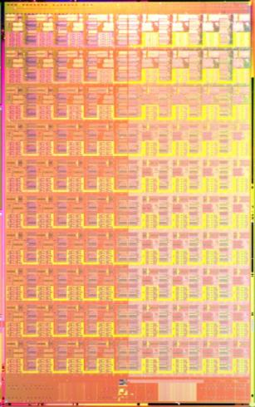
Teraflops Research Processor
12.64mm
Goals:
Deliver Tera-scale performance
  Single precision TFLOP at desktop power
  Frequency target 5GHz
  Bi-section B/W order of Terabits/s
  Link bandwidth in hundreds of GB/s
Prototype two key technologies
  On-die interconnect fabric
  3D stacked memory
Develop a scalable design methodology
  Tiled design approach
  Mesochronous clocking
  Power-aware capability
I/O Area
single tile
1.5mm
2.0mm
21.72mm
PLL
PLL
TAP
TAP
I/O Area
I/O Area
Notes:
We’ve demonstrated and described the results from this 80-core chip in many places. These are the specific goals we had for this project.
The key question was to help answer the question of relevance to the mainstream platform by testing whether we could deliver the floating point computation and handle the corresponding data traffic in a power effective way. Both absolute performance power efficiency, and scalability were important. The focus in particular was on two critical technologies on-die interconnect and 3D stacked memory.
Practical, but no less important were the methodological questions. If the effort to design and validate such a processor scaled with performance we would be in trouble. Accordingly we wanted to test the effectiveness of a tiled design approach, a novel clock design together with power management capability that was scalable and modular.

Slide 14
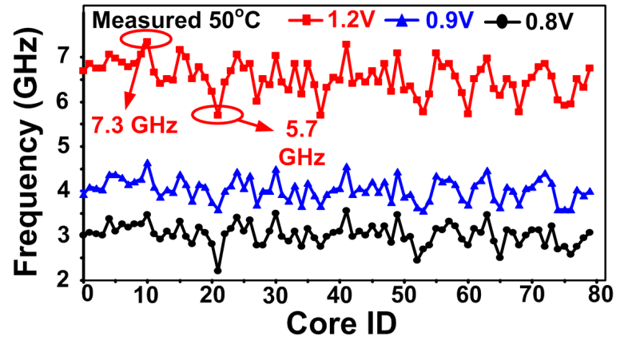
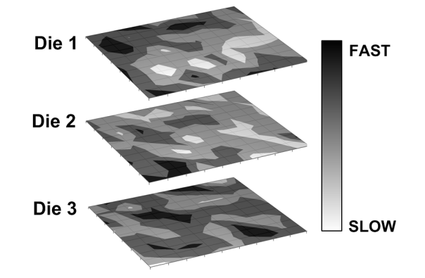
Within-Die Variation-Aware
DVFS and scheduling
Max Frequency variation per core 28% at 1.2V 62% at 0.8V
No correlation die to die – individual characterization required
Improved performance or energy efficiency with:
  Multiple frequency islands
  Dynamic scheduling of processing to core
Dighe, S, et al., “Within-Die Variation-Aware Dynamic Voltage-Frequency Scaling, Core Mapping and Thread Hopping for an 80-Core Processor”, in Proceedings of ISSCC 2010 (IEEE International Solid-State Circuits Conference), Feb. 2010
Notes:
A 45nm Resilient and Adaptive Microprocessor Core
for Dynamic Variation Tolerance
Resilient Core (15.5)
Reduces guardbands by catching & correcting errors when they occur
Allows for up to 40% more performance OR 21% less energy
Resilient Memory (19.6)
Performs adaptive voltage boosts during memory reads & writes
Allows the entire chip to run at low voltages w/ 27% power reduction

Slide 15
Motivations for 2nd Generation – SCC
Many-core processor research
  High-performance power-efficient fabric
  Fine-grain power management
  Message-based programming support
Parallel Programming research
  Better support for scale-out server model
    Operating system, communication architecture
  Scale-out programming model for client
    Programming languages, runtimes
An experimental processor, not a product!

Slide 16

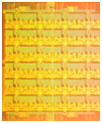
Cloud Computing Today
Cloud datacenters:
  1000s of networked computers
  Millions of threads & petabytes of data
Opportunity:
  Lower power, higher density via integration
  Greater efficiency and better programmability
Example: Intel’s Open Cirrus testbed
Intel Labs Pittsburgh
1 Gb/s
(x4)
Switch
24 Gb/s
1 Gb/s
(x8 p2p)
45 Mb/s T3
to Internet
1 Gb/s
(x4)
1 Gb/s
(x8)
Switch
48 Gb/s
Switch
48 Gb/s
1 Gb/s (x2x5 p2p)
1 Gb/s
(x4)
1 Gb/s
(x4)
1 Gb/s
(x4)
1 Gb/s
(x4)
1 Gb/s
(x4)
Mobile Rack
8 (1u) nodes
64 cores
Future:
Many-core
Processor?
Switch
48 Gb/s
Switch
48 Gb/s
Switch
48 Gb/s
Switch
48 Gb/s
Switch
48 Gb/s
3U Rack
5 storage nodes
12 1TB Disks
1 Gb/s
(x4x4 p2p)
1 Gb/s
(x4x4 p2p)
1 Gb/s
(x15 p2p)
1 Gb/s
(x15 p2p)
1 Gb/s
(x15 p2p)
Blade Rack
40 nodes
140 cores
Blade Rack
40 nodes
320 cores
1U Rack
15 nodes
240 cores
2U Rack
15 nodes
360 cores
2U Rack
15 nodes
240 cores
Notes:
But scaling to many processors is commonplace in today’s cloud computing datacenters.
They use scale-out
Move scale out on die – benefit both the datacenter and client with integration and exploit the programming models.

Slide 17
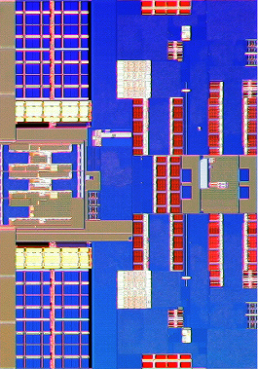
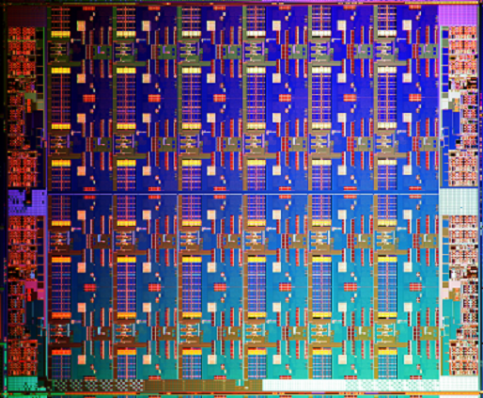
Single-chip Cloud Computer
Experimental Processor
3.6mm
26.5mm
L2$1
Core1
TILE
DDR3 MC
DDR3 MC
5.2mm
Router
MPB
21.4mm
PLL
JTAG
L2$0
Core0
TILE
DDR3 MC
DDR3 MC
Technology | 45nm Hi-K CMOS
Interconnect | 9 Metal (Cu)
Transistors | Die: 1.3B, Tile: 48M
Tile Area | 18.7mm²
Die Area | 567.1mm²
VRC
System Interface + I/O
Howard, J, et al., “A 48-Core IA-32 Message-Passing Processor with DVFS in 45nm CMOS”, in Proceedings of ISSCC 2010 (IEEE International Solid-State Circuits Conference), Feb. 2010
Notes:
2nd Generation Intel Labs experimental processor
“Cluster-on-die” architecture
48 Pentium™ Processor cores (P54C - x87FP only)
No HW cache concurrency support
Message-passing support
SW-controlled Fine-grain power management
System I/F for I/O accesses
8-byte bidirectional
6.4GB/s of I/O bandwidth

Slide 18
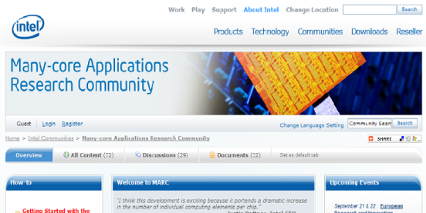
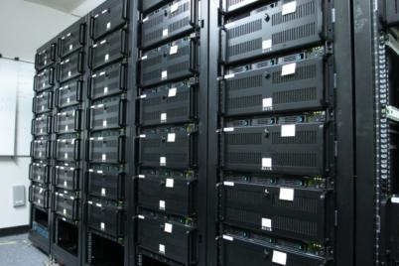
MARC - Many-core Application Research Community
Worldwide research partnership program with academia & industry
Providing access to SCC for many-core programming research
Overwhelming interest - ~200 research proposals received
SCC datacenter is online - Community website up and running
    http://communities.intel.com/community/marc
Notes:
61 institutions under contract. Shipped 27 SCC systems to MARC partners; 14 in Europe. 36 external partners w/65 individual researchers have registered on the MARC website. 16 SCC systems in the datacenter have been allocated to external partners. Received permission from 33 institutes to use their name in MARC related press releases.
Altreonic, Reservoir Labs, ET International, Hasso-Plattner-Institute
Barcelona Supercomputing Center
ETH Zurich
FORTH-ICS (U Crete)
Fraunhofer-Institute for Optronics
Galicia Supercomputing Center (CESGA)
Karlsruhe Institute of Technology (KIT)
Lessius-Mechelen, Campus De Nayer
Linköping University
RWTH Aachen University
Sabanci University
Seoul National University
Swiss Federal Institute Zurich (Univ)
Tsinghua University
TU Braunschweig
TU Cottbus
Turku University
UNICAMP
University of Amsterdam
University of Auckland, New Zealand
University of Bayreuth
University of Bologna
University of Edinburgh
University of Erlangen
University of Glasgow
University of Innsbruck
University of Oxford
University of Paderborn
University of Potsdam
University of Toronto
University of Vienna
Purdue Univ, Rutgers Univ
SUNY Binghamton
UC San Diego
University of Missouri Kansas
University of Michigan Ann Arbor
University of Texas Austin

Slide 19
SCC Academic Research Examples
Programming Models
SW managed coherence / SVM
SW transactional memory
On-chip pipelining with on-die memory
Operating Systems
Scalable OS for MC architectures
RTOS for MC architectures
Fault tolerant operating systems
MPI
Lightweight MPI for on-die clusters
Power/Resource aware programming
Efficient collective algorithms
Collective I/O
Virtual Topology Mechanisms
Middleware
Compilers/Runtimes for multi-
dimensional optimizations
High productivity parallel
programming languages
Resource Management

Slide 20
Summary
Intel research is addressing the challenges of scaling to tera-scale performance
  Workload, programming, silicon prototypes
SCC provides a unique experimental platform for many-core research
  Datacenter and future clients
We are sharing SCC with selected researchers in academia and industry
    http://communities.intel.com/community/marc

Slide 21
Agenda
09:00 Welcome and Opening Remarks
09:15 Jesse: Keynote Speech
09:45 Jim Held: Keynote Speech
10:45 Break
11:00 SCC Hardware Architecture Overview
11:50 Lunch – Informal discussions & SCC Demo
13:30 Today’s SCC Software Environment
14:10 Message Passing on the SCC
14:50 Software-Managed Coherency
15:30 Break
15:50 Application ”Deep Dive”
16:20 Many-core Applications Research Community
16:40 Experience Sharing
17:10 Q&A
17:30 Adjourn

Slide 22
Agenda
09:00 Welcome and Opening Remarks
09:15 Jesse: Keynote Speech
09:45 Jim Held: Keynote Speech
10:45 Break
11:00 SCC Hardware Architecture Overview
11:50 Lunch – Informal discussions & SCC Demo
13:30 Today’s SCC Software Environment
14:10 Message Passing on the SCC
14:50 Software-Managed Coherency
15:30 Break
15:50 Application ”Deep Dive”
16:20 Many-core Applications Research Community
16:40 Experience Sharing
17:10 Q&A
17:30 Adjourn

Slide 23
SCC Architecture and Design Overview
Gansha Wu
Intel Labs China
Intel Labs Single-chip Cloud Computer Symposium
December, 2010

Slide 24
Agenda
Feature set
Architecture overview
  Core
  Interconnect Fabric
  Memory model & Message passing
  I/O and System Overview
Design Overview
  Tiled design methodology
  Clocking
  Power management
Results
Summary
Notes:
24

Slide 25
SCC Feature set
First Si with 48 iA cores on a single die
Power envelope 125W Core @1GHz, Mesh @2GHz
Message passing architecture
    No coherent shared memory
    Proof of Concept for scalable solution for many core
Next generation 2D mesh interconnect
    Bisection B/W 1.5Tb/s to 2Tb/s, avg. power 6W to 12W
Fine grain dynamic power management
    Off-die VRs
Notes:
Rock Creek prototype is designed with a few specific Hardware and Software research goals. The prototype processor is designed to demonstrate these goals and help software developers expedite their research initiatives with the help of this hardware setup.
Let me walk you thru primary goals and the design features to support the research agenda. I will focus primarily on the hardware research goals and then Tim Matson who leads Software development research will walk thru and explain what they are planning on doing with this prototype set up and pursue their research goals.
This is our second prototype as part of Terascale computing research initiative. Compared to our first one the performance goals on this one are quite modest.
25

Slide 26
Die Architecture
MC1
MC3
L2$1
256KB
IA-32 Core1
Router
MPB16KB
16B
MC0
MC2
L2$0
256KB
IA-32 Core0
VRC
System Interface
Router Tile
2 core clusters in 6x4 2-D mesh

Slide 27
Core Memory Management
Core cache coherency is restricted to private memory space
  Maintaining cache coherency for shared memory space is under software control
Each core has an address Look Up Table (LUT) extension
  Provides address translation and routing information
LUT must fit within the core and memory controller constraints
LUT boundaries are dynamically programmed
CORE0 LUT Example
255
Boot
Maps to MC0
254
Maps to VRC
Shared
Maps to MPBs
…
…
1GB
Private
Maps to MC0
1
0

Slide 28
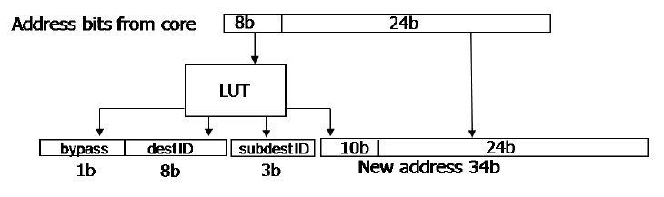
Address Translation:
From Core Address to System Address

Slide 29
On-Die 2D Mesh
16B wide data links + 2B sideband
    Target frequency: 2GHz
    Bisection bandwidth: 2 Tb/s
    Latency: 4 cycles (2ns)
2 message classes and 8 VCs
Low power circuit techniques
    Sleep, clock gating, voltage control, low power RF
    Low power 5 port crossbar design
Speculative VC allocation
Route pre-computation
Single cycle switch allocation
29
Notes:
29

Slide 30
Router Architecture
16B
Route Pre-compute
VC Allocation
FIFO
16B
Input Arbitration
Switch Arbitration
In-Port 0
Cycle 1
Cycle 2
Cycle 3
Cycle 4
Frequency | 2GHz @ 1.1V
Latency | 4 cycles
Link Width | 16 Bytes
Bandwidth | 64GB/s per link
Architecture | 8 VCs over 2 MCs
Power Consumption | 500mW @ 50°C
30

Slide 31
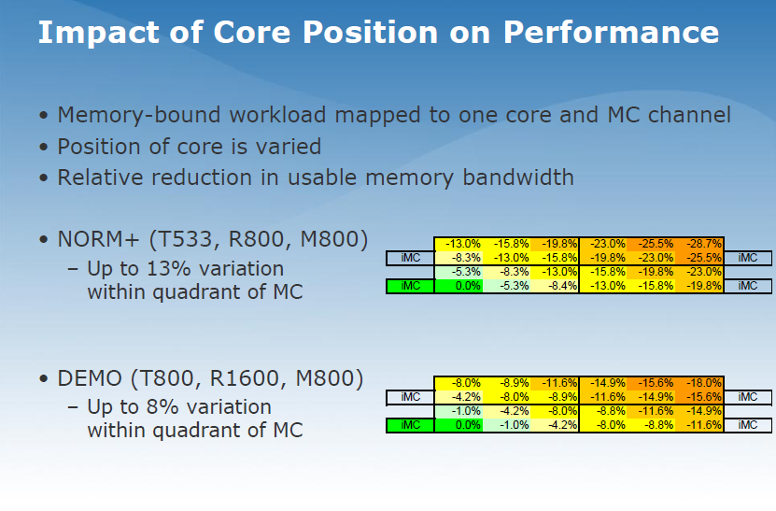

Slide 32
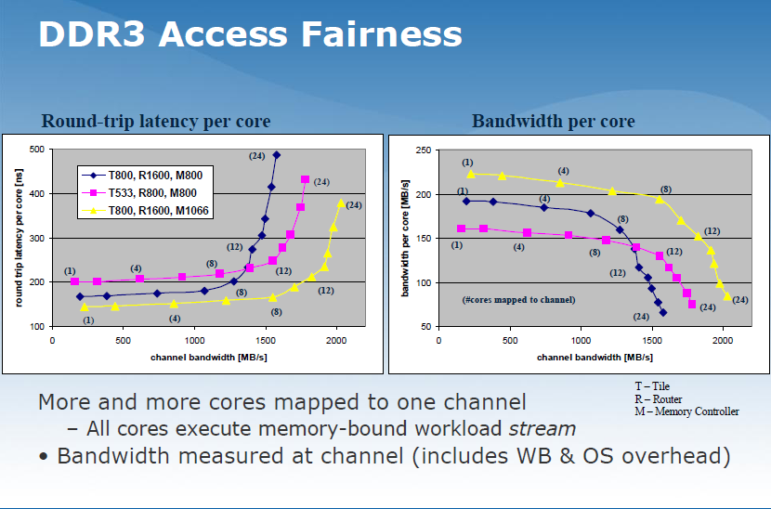

Slide 33
Message Passing on SCC
Message passing is done through shared memory space
Two classes of shared memory:
  Off-die, DRAM: Uncachable shared memory … results in high latency message passing
  On-die, message passing buffers (MPB) … low latency message passing
    On-die dedicated message buffers placed in each tile to improve message passing performance
    Message bandwidth improved to 1 GB/s
Notes:
33

Slide 34
Message Passing Protocol
Message Passing Protocol
Cores communicate through small fast messages
  L1 to L1 data transfers
  New Message Passing Data Type (MPDT)
Message passing Buffer (MPB) – 16KB
  1 MPB per tile for 384KB of on-die shared memory
  MPB size coincides with L1 caches
Core A - L1$
1. Data Move
3. MPB write
2. MP write miss
16KB Message Passing Buffer
Core B - L1$
5. MPB read
6. Data Move
4. MP read miss
Non-coherent Memory Space
Coherent Memory Space

Slide 35
Dedicated Message Buffers
Cache line transfers into L1 cache of receiving core implemented through on-die message passing buffers
Each tile has 16KB MPB
Part of the shared memory space is statically mapped into MPB in each tile rather than into memory controller
Messages larger than MPB can still go out to main memory
Local write, remote read
Remote write, local read
Notes:
35

Slide 36
System Interface
JTAG access to config system while in reset/debug
    Done on Power Reset from Management Console PC
    Configuring memory controller etc.
    Reset cores with default configuration
Management Console PC can use Mem-mapped registers to modify default behavior
    Configuration and voltage control registers
    Message passing buffers
    Memory mapping
Preload image and reset rather than PC bootstrap
    BIOS & firmware a work in progress
Notes:
36

Slide 37
SCC system overview
PLL
JTAG
I/O
JTAG
BUS
RPC
SCC die
System FPGA
Management Console PC
PCIe

Slide 38
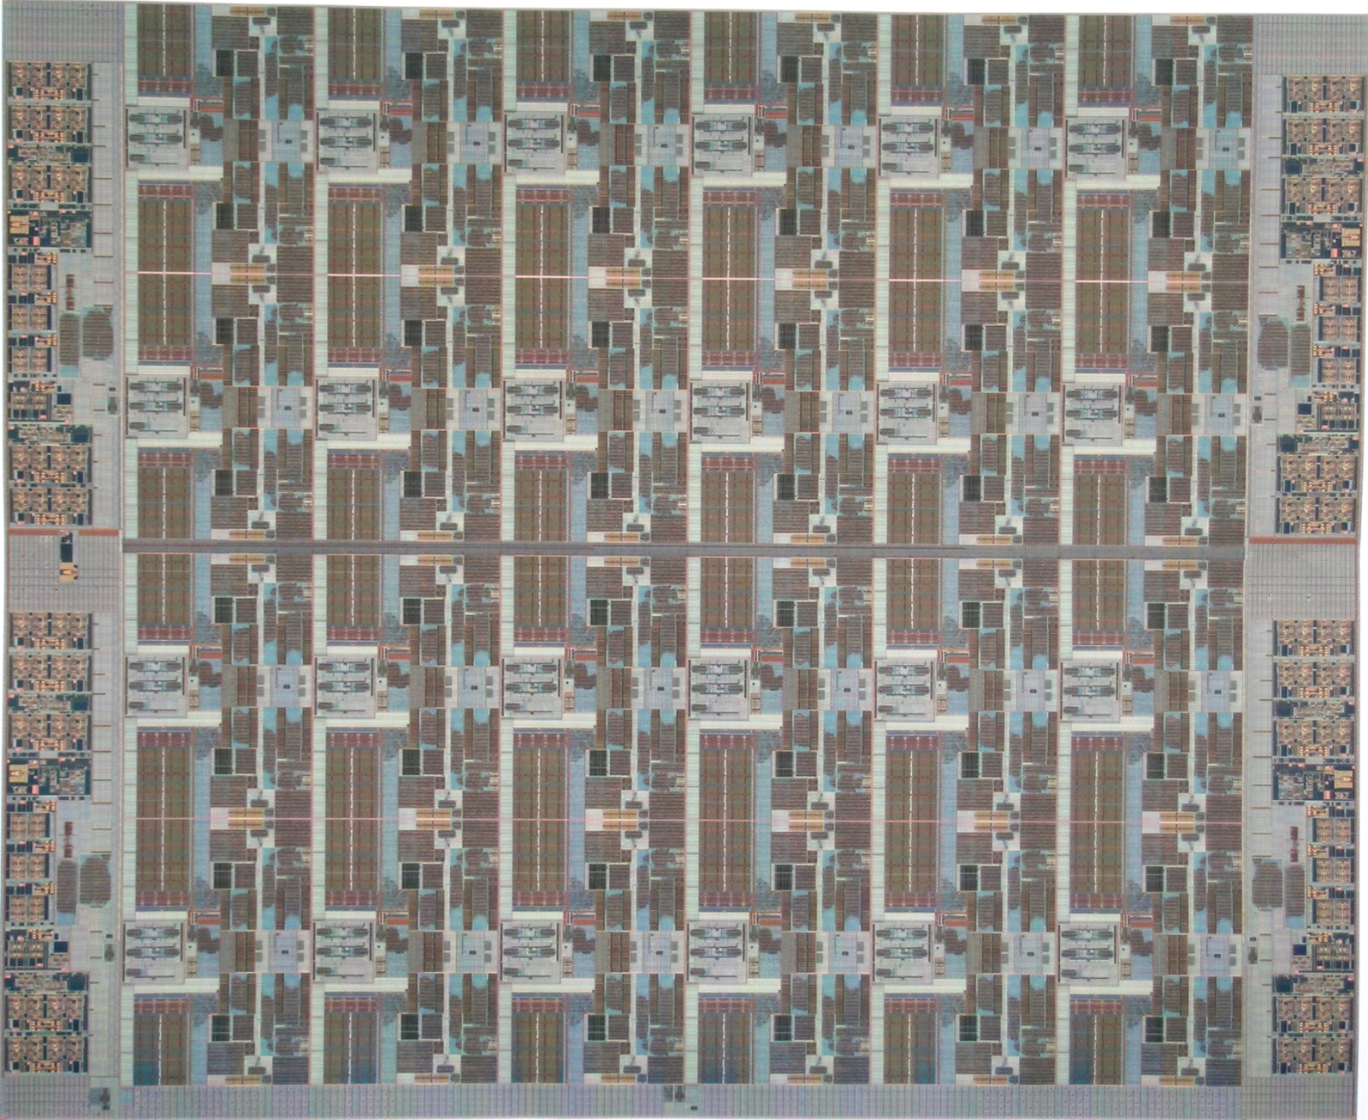
SCC full chip
26.5mm
SCC
TILE
Technology | 45nm Process
Interconnect | 1 Poly, 9 Metal (Cu)
Transistors | Die: 1.3B, Tile: 48M
Tile Area | 18.7mm²
Die Area | 567.1mm²
DDR3
DDR3
MC
MC
PLL +
I/O
JTAG
SCC
21.4mm
TILE
DDR3
DDR3
MC
MC
13
RPC
System Interface + I/O
38

Slide 39
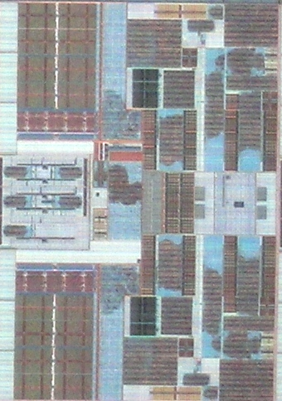
SCC Dual-core Tile
2 P54C cores (16K L1$/core)
256K L2$ per core
8K Message passing buffer
Clock Crossing FIFOs b/w Mesh interface unit and Router
L2$ + CC
P54c
CCF
CCF
MPB
MIU
GCU
Router
MIU
MPB
GCU
Tile area 18.7mm²
Core are 3.9mm²
Cores and uncore units @1GHz
Router @2GHz
L2$ + CC
P54c
L2$ + CC
P54c

Slide 40
Clock Distribution
Port_En
L2$1 clk
Core1_En
Port CLKs
Router_En
L2$1_En
Core1 clk
Tile_EN
MC1
MC3
[4:0]
Core0 clk
L2$0_En
Core1_En
L2$0 clk
PLL
Balanced H-tree clock distribution
Designed to provide 4GHz clock to tile entry points
Simulated skew for adjacent tiles – 5ps
Cross die skew irrelevant
MC0
MC2
VRC
SIF
Router Tile Clock Gating
40

Slide 41
Voltage and Frequency islands
27 Frequency Islands (FI) 8 Voltage Islands (VI)

Slide 42
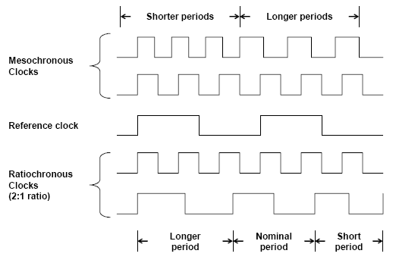
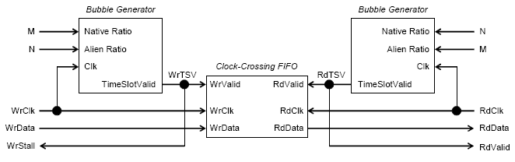
SCC Clock Crossing FIFO (CCF)
6 entry deep FIFO, 144-bits wide
Built-in Voltage translation: M, N ratios and pointer separation scanned in
Key Benefit: independent mesh & tile frequency
Vcc₁, F₁
Vcc₂, F₂

Slide 43
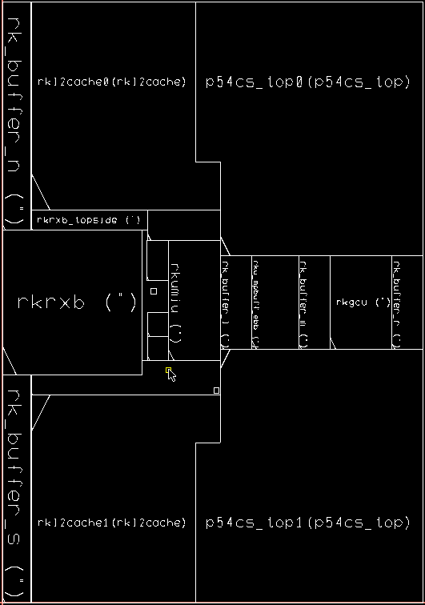
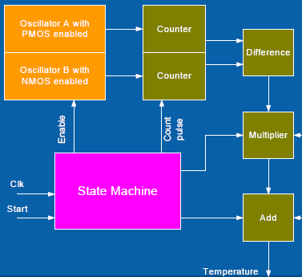
Closed Loop Thermal Management
Network of digital temperature sensors
  2 per Tile, 48 total on chip
  Programmable 13-bit counters via FSM (State Machine)
  Outputs written to Config registers
    Readable by any P54c core for DVFS
  Readable by core/JTAG and via 2D mesh/SIF
SCC_TILE
Oscillators
Config/Scan
To P54c
And JTAG

Slide 44
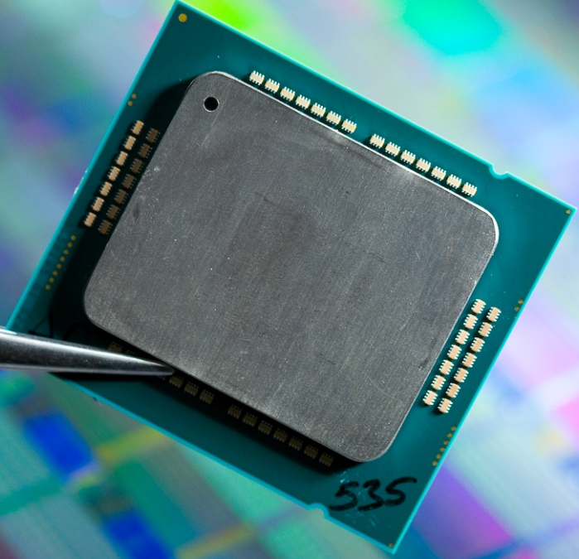
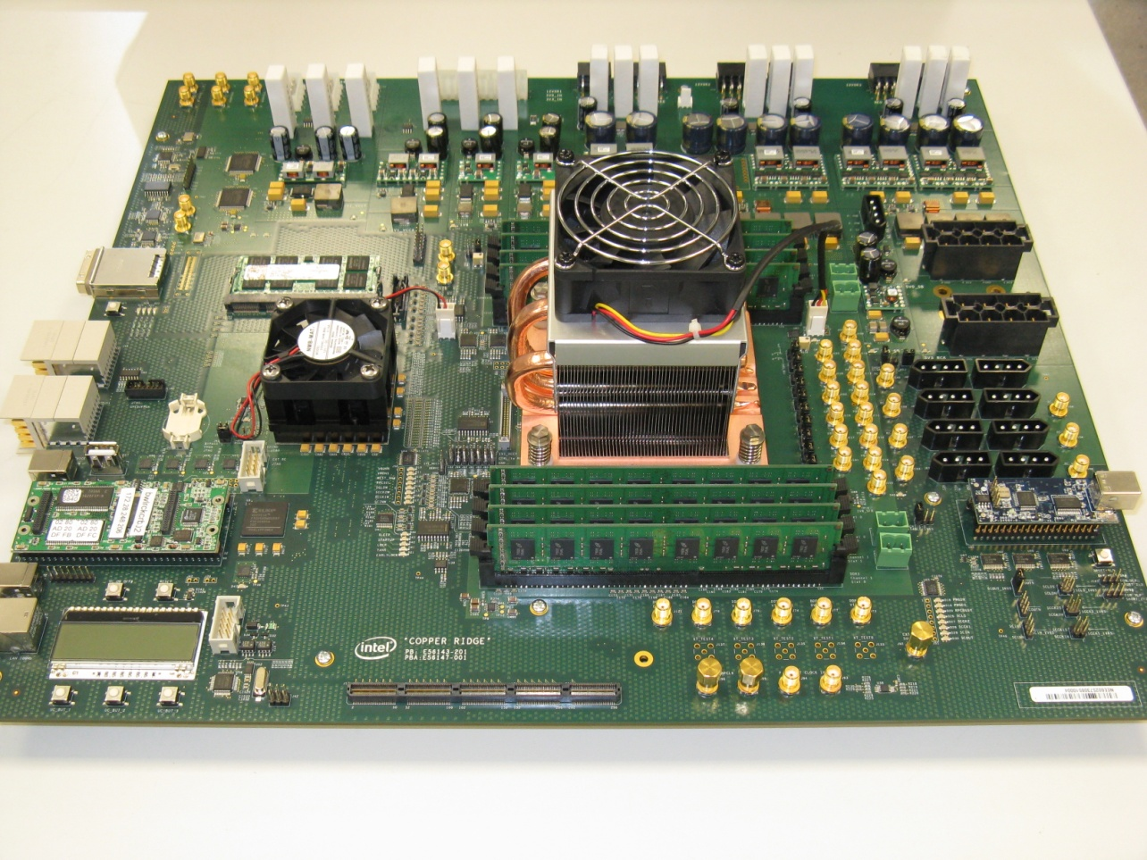
Package and Test Board
Technology | 45nm Process
Package | 1567 pin LGA package
 | 14 layers (5-4-5)
Signals | 970 pins

Slide 45
Core & Router Fmax

Slide 46
Measured full chip power

Slide 47
Power breakdown

Slide 48
Summary
A 48 IA-32 core processor in 45nm CMOS
  Second generation 2D-mesh network
  4 DDR3 channels in a 6×4
  Highest level of IA-32 integration
New message passing HW for increased performance
  384KB of on-die shared memory
  Message passing memory type
Power management employs 8VIs and 28FIs for DVFS
Chip dissipates between 25W and 125W as performance scales
  25W at 0.7, 125MHz core, 250MHz mesh and 50°C
  125W at 1.14V, 1GHz core, 2GHz mesh and 50°C

Slide 49
Agenda
09:00 Welcome and Opening Remarks
09:15 Jesse: Keynote Speech
09:45 Jim Held: Keynote Speech
10:45 Break
11:00 SCC Hardware Architecture Overview
11:50 Lunch – Informal discussions & SCC Demo
13:30 Today’s SCC Software Environment
14:10 Message Passing on the SCC
14:50 Software-Managed Coherency
15:30 Break
15:50 Application ”Deep Dive”
16:20 Many-core Applications Research Community
16:40 Experience Sharing
17:10 Q&A
17:30 Adjourn

Slide 50
Agenda
09:00 Welcome and Opening Remarks
09:15 Jesse: Keynote Speech
09:45 Jim Held: Keynote Speech
10:45 Break
11:00 SCC Hardware Architecture Overview
11:50 Lunch – Informal discussions & SCC Demo
13:30 Today’s SCC Software Environment
14:10 Message Passing on the SCC
14:50 Software-Managed Coherency
15:30 Break
15:50 Application ”Deep Dive”
16:20 Many-core Applications Research Community
16:40 Experience Sharing
17:10 Q&A
17:30 Adjourn

Slide 51
sccKit
Software framework for SCC Platform
Xiaocheng Zhou
Intel Labs China
Intel Labs Single-chip Cloud Computer Symposium
December, 2010

Slide 52
Content
Platform
  Platform overview
  System Interface FPGA bitstream
  Board management controller (BMC) firmware
SCC Software
  Customized Linux
  bareMetalC
Management Console PC Software
  PCIe driver with integrated TCP/IP driver
  Programming API for communication with SCC platform
  GUI for interaction with SCC platform
  Command line tools for interaction with SCC platform
Live Demo and outlook

Slide 53
Content
Platform
  Platform overview
  System Interface FPGA bitstream
  Board management controller (BMC) firmware
SCC Software
  Customized Linux
  bareMetalC
Management Console PC Software
  PCIe driver with integrated TCP/IP driver
  Programming API for communication with SCC platform
  GUI for interaction with SCC platform
  Command line tools for interaction with SCC platform
Live Demo and outlook

Slide 54
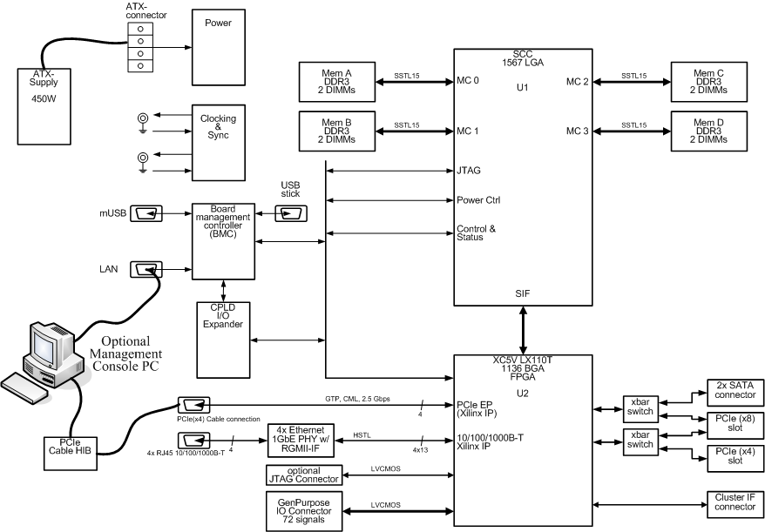
SCC Platform Board Overview
Notes:
Elaborate on
BMC (ARM)
FPGA

Slide 55
SCC “Chipset”
System Interface FPGA
  Connects to SCC Mesh interconnect
  IO capabilities like PCIe, Ethernet & SATA
  Bitstream is part of sccKit distribution
Board Management Controller (BMC)
  JTAG interface for Clocking, Power etc.
  USB Stick with FPGA bitstream
  Network interface for User intercation via Telnet
  Status monitoring
  Firmware is part of sccKit distribution

Slide 56
Content
Platform
  Platform overview
  System Interface FPGA bitstream
  Board management controller (BMC) firmware
SCC Software
  Customized Linux
  bareMetalC
Management Console PC Software
  PCIe driver with integrated TCP/IP driver
  Programming API for communication with SCC platform
  GUI for interaction with SCC platform
  Command line tools for interaction with SCC platform
Live Demo and outlook

Slide 57
SCC Linux Build
The sccKit comes with a custom Linux build which
can be used to execute own applications:
Kernel 2.6.16 with Busybox 1.15.1
Booting w/o BIOS possible (Kernel mods)
Dropbear ssh
On-die TCP/IP network drivers
Off-die TCP/IP driver for connection to management console including NFS service.
  Current physical medium: PCIe connection
  Transition to Ethernet ports of Rocky Lake board in next Release
Drivers for low level access to SCC specific hardware (e.g. MPB).
SATA driver under development (latest Q1/2011)

Slide 58
SCC Linux Apps
Cross-compilers for Pentium processor compatible IA cores available (C++, Fortran)
Write own low level device drivers for deeper dives.
Cross compiled MPI2 including iTAC trace analyzer available.

Slide 59
Creating own SCC binaries
It is also possible to write software that directly executes on SCC cores such as an operating system.
C++ based programming framework “bareMetalC” is available and allows direct access to all dedicated SCC hardware features (e.g. MPB).
Up sides | Down sides
Direct access to low level features of SCC. | Limited IO capabilities.
No overhead from OS. | Harder to debug.
Full flexibility. | Low level coding w/o OS

Slide 60
bareMetalC Apps
bareMetalC used for bring-up and production tests (e.g. BIST test)
Useful for creation of own low level apps (e.g. customized OS)
SCC communication environment (RCCE) with MPI-like API available including several applications

Slide 61
Content
Platform
  Platform overview
  System Interface FPGA bitstream
  Board management controller (BMC) firmware
SCC Software
  Customized Linux
  bareMetalC
Management Console PC Software
  PCIe driver with integrated TCP/IP driver
  Programming API for communication with SCC platform
  GUI for interaction with SCC platform
  Command line tools for interaction with SCC platform
Live Demo and outlook

Slide 62
PCIe driver with Ethernet
Management Console PC comes with PCIe driver that provides:
  TCP/IP connection to SCC
  Connection to Management Console PC applications.
  Access to all memory and register locations of SCC.

Slide 63
Creating Management Console PC Apps
Written in C++ making use of Nokia Qt cross-platform application and UI framework.
Low level API (sccApi) with access to SCC and board management controller via PCIe.
Code of sccGui as well as command line tools is available as code example. These tools use and extend the low level API.
Hardware abstraction
sccApi
C++ class for low level access to Hardware.
sccExtApi
Inherited C++ class with application specific features.
Application
Actual app (e.g. sccGui) that doesn‘t need to care for low level access...

Slide 64
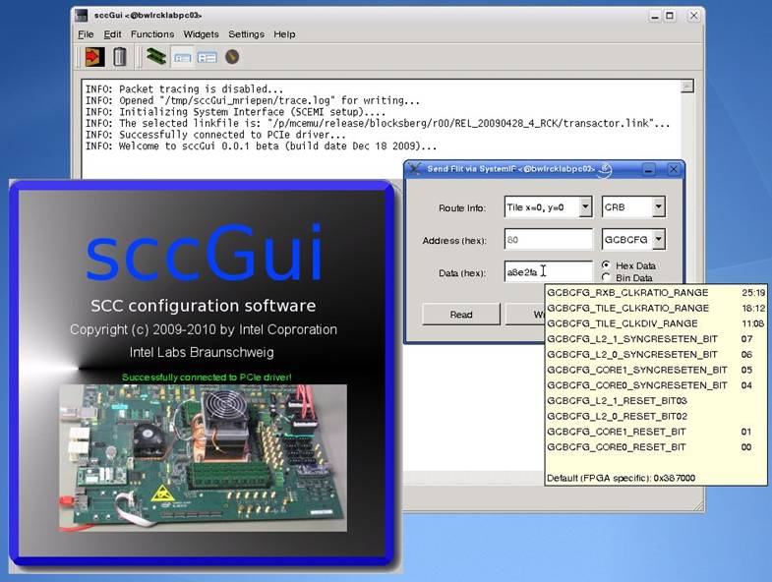
sccGui
Read and write
system memory and
registers.
Boot OS or other
workloads
(e.g. bareMetalC).
Open SSH connections
to booted Linux cores
Performance meter
Initialize Platform via Board Management Controller.

Slide 65
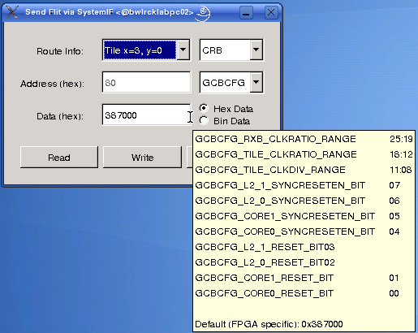
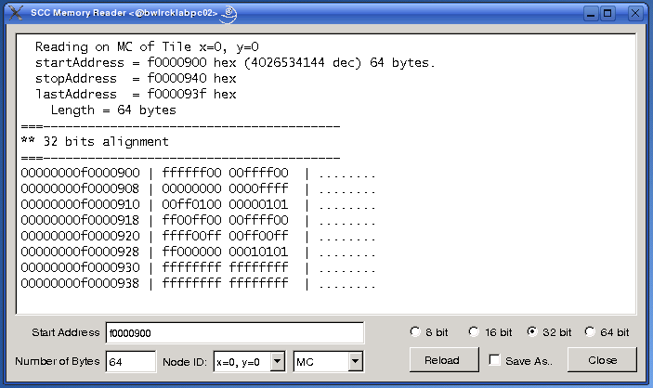
sccGui for debugging
Modify registers
Read system memory

Slide 66
sccBoot & sccReset
sccBoot:
A command-line tool that allows to boot Linux on selected cores and to check the status (“which cores are currently booted”). It also allows to boot generic workloads (e.g. bareMetalC applications)
sccReset:
A command-line tool that allows to reset selected SCC cores.

Slide 67
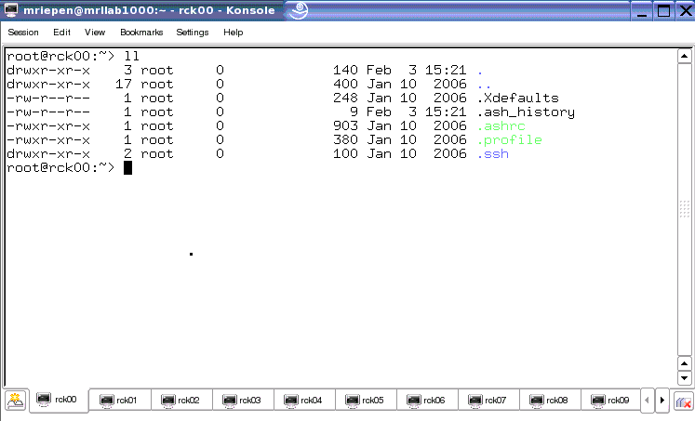
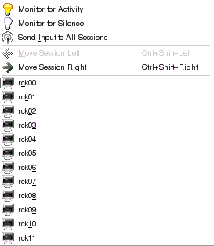
sccKonsole
Regular konsole, with automatic login to selected cores.
Enables broadcasting amongst shells.
No graphic support.

Slide 68
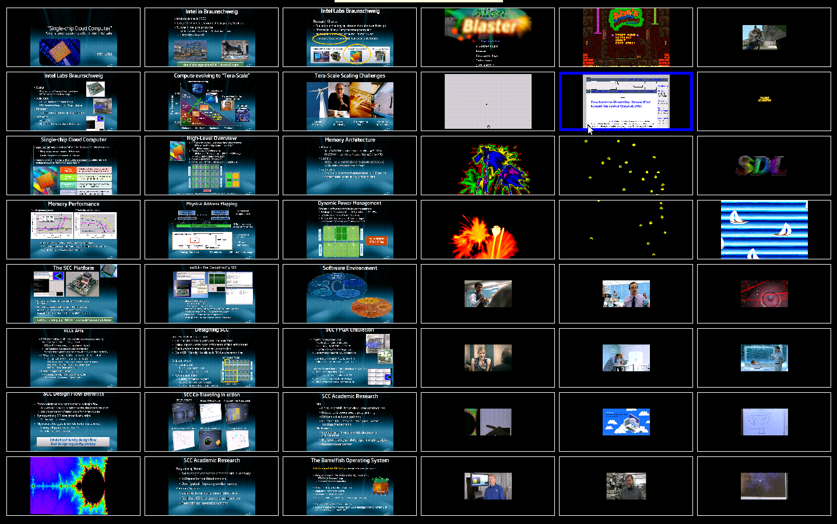
sccDisplay (coming in next release)
48 (!)
virtual
displays
with full
graphics
support...
Graphical konsoles with virtual graphics cards.
Forwards keyboard and mouse commands to cores.
Allows preview over all virtual framebuffers (photo).

Slide 69
Content
Platform
  Platform overview
  System Interface FPGA bitstream
  Board management controller (BMC) firmware
SCC Software
  Customized Linux
  bareMetalC
Management Console PC Software
  PCIe driver with integrated TCP/IP driver
  Programming API for communication with SCC platform
  GUI for interaction with SCC platform
  Command line tools for interaction with SCC platform
Live Demo and outlook

Slide 70
SCC Live Demo
Notes:
During the Live Demo we‘re going to show:
sccGui:
Booting Linux
Perfmeter
Konsole
Debugging features (Memory reader)
Command line tools:
sccBoot
sccKonsole
sccReset
sccKit sources
Short demo of sccKit platform software partinioning
Short introduction to sccApi (foundation for own Debug PC apps)

Slide 71
Future
Linux will be the default OS for self-contained booting
Self-boot firmware is in preparation
Let‘s shape the future together!
More to be defined…

Slide 73
BACKUP/REFERENCE

Slide 74
sccApi PIO memory methods
// writeFlit: This method sends a non-cachable Flit (64 bit data) to the specified SCC
// System address
bool writeFlit(int Route, int SubdestID, uInt64 Address, uInt64 Data, int sif_port=SIF_RC_PORT);
// readFlit: This method reads a non-cachable Flit (64 bit data) from the specified Rock
// SCC System address
uInt64 readFlit(int Route, int SubdestID, uInt64 Address, int sif_port=SIF_RC_PORT);
// readFlit: This method does the same but allows to evaluate the status of
// transfer_packet()
bool readFlit(int Route, int SubdestID, uInt64 Address, uInt64 *Data, int sif_port=SIF_RC_PORT);
// transferPacket: This is a PIO transfer routine (also used by writeFlit and readFlit)
// that allows to read or write from/to a specified SCC system address. The transfer may
// be non-cachable (64bit) or Cacheline based (256 bit).
bool transferPacket(int routeid, int destid, uInt64 address, int command, unsigned char byteenable, uInt64* data, int sif_port, int commandPrefix = NOGEN);

Slide 75
sccApi DMA memory methods
// read32: This method allows block reads (with DMA, if enabled) from a memory that is
// specified with a SCC System address
uInt32 read32(int routeid, int destid, uInt64 startAddress, char memBlock[], uInt32 numBytes, int sif_port=SIF_RC_PORT, QProgressDialog *pd=NULL);
// write32: This method allows block write access (with DMA, if enabled) to a memory that // is specified with a SCC System address
uInt32 write32(int routeid, int destid, uInt64 startAddress, char memBlock[], uInt32 numBytes, int sif_port=SIF_RC_PORT, QProgressDialog *pd=NULL);

Slide 76
sccApi BMC access methods
// openBMCConnection: Connects to BMC Server and returns success.
bool openBMCConnection();
// connectedBMCServer: Finds out if BMC Server is connected.
bool connectedBMCServer();
// executeBMCCommand: Sends specific command to BMC.
QString executeBMCCommand(QString command);
// processRCCFile: Parses a batch file and passes each command to BMC.
bool processRCCFile(QString fileName, int echo = ECHO_ON, QProgressDialog *pd = NULL);

Slide 77
Agenda
09:00 Welcome and Opening Remarks
09:15 Jesse: Keynote Speech
09:45 Jim Held: Keynote Speech
10:45 Break
11:00 SCC Hardware Architecture Overview
11:50 Lunch – Informal discussions & SCC Demo
13:30 Today’s SCC Software Environment
14:10 Message Passing on the SCC
14:50 Software-Managed Coherency
15:30 Break
15:50 Application ”Deep Dive”
16:20 Many-core Applications Research Community
16:40 Experience Sharing
17:10 Q&A
17:30 Adjourn

Slide 78
Rapidly
Communicating
Cores
Env.
R C C E
A small library for many-core communication
Reduced
Compact
Communication
Environment
Research
Cores
Communication
Environment
Rabble-of
Communicating
Cores
Experiments
Rock
Creek
Communication
Environment
Liang You
ICCPC
Radically
Cool
Coordination
E-science
Richly
Communicating
Cores
Ecosystem
Restricted
Capability
Communication
Environment
Rorschach
Core
Communication
Express
Intel Labs Single-chip Cloud Computer Symposium
December, 2010

Slide 79
Agenda
Views of SCC: HW, SW and Platforms
RCCE: A communication environment for application programmers.
Benchmarks and Results
Power management

Slide 80
Top Level Hardware Architecture
6x4 mesh 2 Pentium™ P54c cores per tile
256KB L2 Cache, 16KB shared MPB per tile
4 iMCs, 16-64 GB total memory
Tile
Tile
Tile
Tile
Tile
Tile
Tile
R
R
R
R
R
R
Core 1
L2$1
Core 1
Memory Controller
Tile
Tile
Tile
Tile
Tile
Memory Controller
Tile
R
R
R
R
R
R
Router
MPB
Tile
Tile
Tile
Tile
Tile
Tile
Core 0
R
R
R
R
R
R
L2$0
Core 0
Memory Controller
Memory Controller
Tile
Tile
Tile
Tile
Tile
Tile
R
R
R
R
R
R
Tile area: ~17 mm²
SCC die area: ~567 mm²
System I/F
R = router, iMC = integrated Memory Controller, MPB = message passing buffer

Slide 81
Programmer’s view of SCC
48 x86 cores with the familiar x86 memory model for Private DRAM
3 memory spaces, with fast message passing between cores
      ( / means on/off-chip)
Shared off-chip DRAM (variable size)
…
t&s
t&s
Private DRAM
CPU_0
Private DRAM
CPU_47
L2$
L1$
L2$
L1$
Shared on-chip Message Passing Buffer (8KB/core)
t&s
Shared test and set register
81
Notes:
测试和设置 指令为单指令用于写入某个内存位置并返回它的旧值的原子操作。 如果有多个进程可以访问相同的内存，如果一个进程正在执行测试和设置，没有其他进程可能开始另一个测试和设置，直到第一个进程已经完成。

Slide 82
SCC Software research goals
Understand programmability and application scalability of many-core chips.
Answer question “what can you do with a many-core chip that has (some) shared non-cache-coherent memory?”
Study usage models and techniques for software controlled power management
Sample software for other programming model and applications researchers (industry partners, Flame group at UT Austin, UPCRC, YOU …)
Our research resulted in a light weight, compact, low latency communication library called RCCE (pronounced “Rocky”)
Third party names are the property of their owners.
Notes:
UT Austin的Flame团队，UPCRC：Universal Parallel Computing Research Center通用并行计算研究中心。

Slide 83

SCC Platforms
Three platforms for SCC and RCCE
  Functional emulator (on top of OpenMP)
  SCC board with two “OS Flavors” … Linux or Baremetal
  (i.e. no OS)
Apps
Apps
Apps
RCCE
RCCE
RCCE
icc
ifort
MKL
RCCE_EMU Driver
icc MKL
icc fort MKL
OpenMP
Baremetal C
Linux
PC or server with
Windows or Linux
Rock creek
Rock creek
Functional emulator, based on OpenMP.
SCC board – NO OpenMP
RCCE supports greatest common denominator between the three platforms
Third party names are the property of their owners.
83
Notes:
greatest common denominator：最大公约数

Slide 84
Agenda
Views of SCC: HW, SW and Platforms
RCCE: A communication environment for application programmers.
Benchmarks and Results
Power management

Slide 85
High level view of RCCE
RCCE is a compact, lightweight communication environment.
  SCC and RCCE were designed together side by side:
    … a true HW/SW co-design project.
RCCE is a research vehicle to understand how message passing APIs map onto many core chips.
RCCE is for experienced parallel programmers willing to work close to the hardware.
RCCE Execution Model:
  Static SPMD:
    identical UEs created together when a program starts (this is a standard approach familiar to message passing programmers)
UE: Unit of Execution … a software entity that advances a program counter (e.g. process of thread).
Notes:
SPMD：Single Program Multiple Data一段程序处理多个数据。

Slide 86
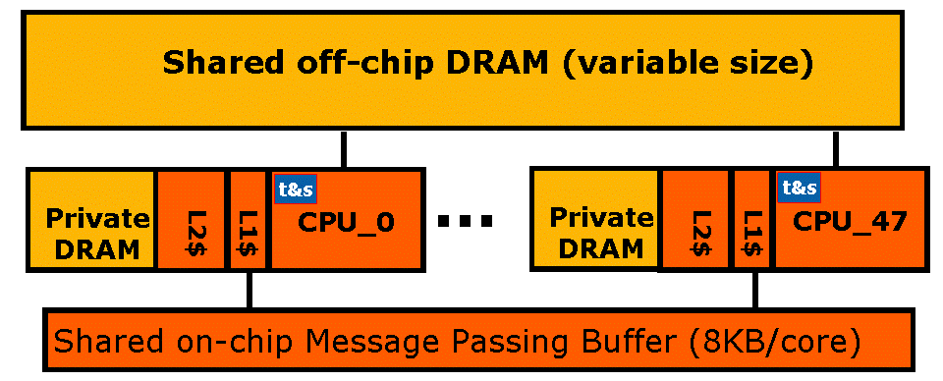
How does RCCE work? Part 1
Message passing buffer memory is special … of type MPBT
Cached in L1, L2 bypassed. Not coherent between cores
Data cached on read, not write. Single cycle op to invalidate all MPBT in L1 … Note this is not a flush
Consequences of MPBT properties:
  If data changed by another core and image still in L1, read returns stale data.
    Solution: Invalidate before read.
  L1 has write-combining buffer; write incomplete line? expect trouble!
    Solution: don’t. Always push whole cache lines
  If image of line to be written already in L1, write will not go to memory.
    Solution: invalidate before write.
Discourage user operations on data in MPB. Use only as a data movement area managed by RCCE … Invalidate early, invalidate often

Slide 87
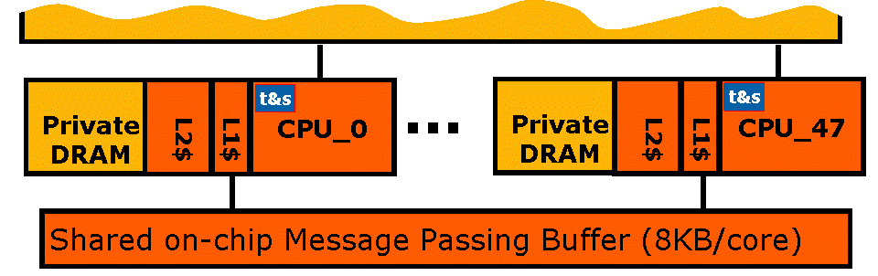
How does RCCE work? Part 2
Treat Msg Pass Buf (MPB) as 48 smaller buffers … one per core.
…
0
1
2
3
47

Slide 88
How does RCCE work? Part 2
Treat Msg Pass Buf (MPB) as 48 smaller buffers … one per core.
Symmetric name space … Allocate memory as a collective op. Each core gets a variable with the given name at a fixed offset from the beginning of a core’s MPB.
…
0
1
2
3
47
A = (double *) RCCE_malloc(size)
Called on all cores so any core can put/get(A at Core_ID) without error-prone explicit offsets
Flags allocated and used to coordinate memory ops
2

Slide 89
How does RCCE work? Part 3
The foundation of RCCE is a one-sided put/get interface.
Symmetric name space … Allocate memory as a collective op. Each core gets a variable with the given name at a fixed offset from the beginning of a core’s MPB.
t&s
t&s
Private DRAM
CPU_0
Private DRAM
CPU_47
L2$
L1$
L2$
L1$
…
0
47
89

Slide 90
How does RCCE work? Part 3
The foundation of RCCE is a one-sided put/get interface.
Symmetric name space … Allocate memory as a collective op. Each core gets a variable with the given name at a fixed offset from the beginning of a core’s MPB.
t&s
t&s
Private DRAM
CPU_0
Private DRAM
CPU_47
L2$
L1$
L2$
L1$
Put(A,0)
…
0
47
90

Slide 91
How does RCCE work? Part 3
The foundation of RCCE is a one-sided put/get interface.
Symmetric name space … Allocate memory as a collective op. Each core gets a variable with the given name at a fixed offset from the beginning of a core’s MPB.
t&s
t&s
Private DRAM
CPU_0
Private DRAM
CPU_47
L2$
L1$
L2$
L1$
Put(A,0)
Get(A, 0)
…
0
47
91

Slide 92
How does RCCE work? Part 3
The foundation of RCCE is a one-sided put/get interface.
Symmetric name space … Allocate memory as a collective op. Each core gets a variable with the given name at a fixed offset from the beginning of a core’s MPB.
t&s
t&s
Private DRAM
CPU_0
Private DRAM
CPU_47
L2$
L1$
L2$
L1$
Put(A,0)
Get(A, 0)
…
0
47
… and use flags to make the puts and gets “safe”
92

Slide 93
The RCCE library
RCCE API provides the basic message passing functionality expected in a tiny communication library:
  One + two sided interface (put/get + send/recv) with synchronization flags and MPB management exposed.
    The “gory” interface for programmers who need the most detailed control over SCC
put()
get()
  Two sided interface (send/recv) with most detail (flags and MPB management) hidden.
    The “basic” interface for typical application programmers.
send()
recv ()
93

Slide 94
Agenda
Views of SCC: HW, SW and Platforms
RCCE: A communication environment for application programmers.
Benchmarks and Results
Power management

Slide 95
Linpack and NAS Parallel benchmarks
Linpack (HPL): solve dense system of linear equations
  Synchronous comm. with “MPI wrappers” to simplify porting
x-sweep
2. BT: Multipartition decomposition
  Each core owns multiple blocks (3 in this case)
  update all blocks in plane of 3x3 blocks
  send data to neighbor blocks in next plane
  update next plane of 3x3 blocks
y-sweep
z-sweep
UE 3
UE 7
UE 11
UE 15
UE 3
3. LU: Pencil decomposition
Define 2D-pipeline process
  await data (bottom+left)
  compute new tile
  send data (top+right)
4
UE 2
4
3
4
UE 1
4
3
2
3
4
UE 0
4
3
2
1
2
3
4
Third party names are the property of their owners.

Slide 96
RCCE functional emulator vs. MPI
HPL implementation of the LINPACK benchmark
GFLOPS
Matrix Order fixed at 2200
4 Intel®Xeon® MP Processors
RCCE 1-bit flags
Standard HPL algorithm variant case numbers
These results provide a comparison of RCCE and MPI on an older 4 processor Intel® Xeon® MP SMP platform* using a tiny 4x4 block size. These are not official MP-LINPACK results.
*3 GHz Intel® Xeon® MP processor in a 4 socket SMP platform (4 cores total), L2=1MB, L3=8MB, Intel® icc 10.1 compiler, Intel® MPI 2.0
Third party names are the property of their owners.
Performance tests and ratings are measured using specific computer systems and/or components and reflect the approximate performance of Intel products as measured by those tests. Any difference in system hardware or software design or configuration may affect actual performance. Buyers should consult other sources of information to evaluate the performance of systems or components they are considering purchasing. For more information on performance tests and on the performance of Intel products, reference <http://www.intel.com/performance> or call (U.S.) 1-800-628-8686 or 1-916-356-3104.

Slide 97
RCCE functional emulator vs. MPI
HPL implementation of the LINPACK benchmark
Low overhead synchronous message passing pays off even in emulator mode (compared to MPI)
GFLOPS
Matrix Order fixed at 2200
4 Intel®Xeon® MP Processors
RCCE 1-bit flags
Standard HPL algorithm variant case numbers
These results provide a comparison of RCCE and MPI on an older 4 processor Intel® Xeon® MP SMP platform* using a tiny 4x4 block size. These are not official MP-LINPACK results.
*3 GHz Intel® Xeon® MP processor in a 4 socket SMP platform (4 cores total), L2=1MB, L3=8MB, Intel® icc 10.1 compiler, Intel® MPI 2.0
Third party names are the property of their owners.
Performance tests and ratings are measured using specific computer systems and/or components and reflect the approximate performance of Intel products as measured by those tests. Any difference in system hardware or software design or configuration may affect actual performance. Buyers should consult other sources of information to evaluate the performance of systems or components they are considering purchasing. For more information on performance tests and on the performance of Intel products, reference <http://www.intel.com/performance> or call (U.S.) 1-800-628-8686 or 1-916-356-3104.

Slide 98
Linpack, on the Linux SCC platform
Linpack (HPL)* strong scaling results:
  GFLOPS vs. # of cores for a fixed size problem (1000).
  This is a tough test … scaling is easier for large problems.
Matrix order 1000
Calculation Details:
  Un-optimized C-BLAS
  Un-optimized block size (4x4)
  Used latency-optimized whole cache line flags
  Performance dropped ~10% with memory optimized 1-bit flags
* These are not official LINPACK benchmark results.
SCC processor 500MHz core, 1GHz routers, 25MHz system interface, and DDR3 memory at 800 MHz.
Third party names are the property of their owners.
Performance tests and ratings are measured using specific computer systems and/or components and reflect the approximate performance of Intel products as measured by those tests. Any difference in system hardware or software design or configuration may affect actual performance. Buyers should consult other sources of information to evaluate the performance of systems or components they are considering purchasing. For more information on performance tests and on the performance of Intel products, reference <http://www.intel.com/performance> or call (U.S.) 1-800-628-8686 or 1-916-356-3104.

Slide 99
LU/BT NAS Parallel Benchmarks, SCC
Problem size: Class A, 64 x 64 x 64 grid*
Using latency optimized, whole cache line flags
* These are not official NAS Parallel benchmark results.
SCC processor 500MHz core, 1GHz routers, 25MHz system interface, and DDR3 memory at 800 MHz.
Third party names are the property of their owners.
Performance tests and ratings are measured using specific computer systems and/or components and reflect the approximate performance of Intel products as measured by those tests. Any difference in system hardware or software design or configuration may affect actual performance. Buyers should consult other sources of information to evaluate the performance of systems or components they are considering purchasing. For more information on performance tests and on the performance of Intel products, reference <http://www.intel.com/performance> or call (U.S.) 1-800-628-8686 or 1-916-356-3104.

Slide 100
Agenda
Views of SCC: HW, SW and Platforms
RCCE: A communication environment for application programmers.
Benchmarks and Results
Power management

Slide 101
RCCE Power Management API
RCCE power management emphasizes safe control: V/GHz changed together within each 4-tile (8-core) power domain.
  A Master core sets V + GHz for all cores in domain.
    RCCE_istep_power():
      steps up or down V + GHz, where GHz is max for selected voltage.
    RCCE_wait_power():
      returns when power change is done
    RCCE_step_frequency():
      steps up or down only GHz
Power management latencies
  V changes: Very high latency, O(Million) cycles.
  GHz changes: Low latency, O(few) cycles.

Slide 102
Conclusions
RCCE software works
  RCCE’s restrictions (Symmetric MPB memory model and blocking communications) have not been a fundamental obstacle
  Functional emulator is a useful development/debug device
SCC architecture
  The on-chip MPB was effective for scalable message passing applications
  Software controlled power management works … but it’s challenging to use because (1) granularity of 8 cores and (2) high latencies for voltage changes
  The Test&set registers (only one per core) will be a bottleneck.
    Sure wish we had asked for more!
Future work
  Add shmalloc() to expose shared off-chip DRAMM (in progress).
  Move resource management into OS/drivers so multiple apps can work together safely.
  We have only just begun to explore power management capabilities … we need to explore additional usage models.

Slide 103
SW Acknowledgements
SCC System software:
Management Console software | Michael Riepen
BareMetalC workflow | Michael Riepen
Linux for SCC | Thomas Lehnig Paul Brett
System Interface FPGA development | Matthias Steidl
TCP/IP network driver | Werner Haas
SCC Application software:
RCCE library and apps | Rob Van der Wijngaart Tim Mattson
Developer tools (Intel compilers and math libraries) | Patrick Kennedy
Mandelbrot app + viz | Michael Riepen

Slide 104
Agenda
09:00 Welcome and Opening Remarks
09:15 Jesse: Keynote Speech
09:45 Jim Held: Keynote Speech
10:45 Break
11:00 SCC Hardware Architecture Overview
11:50 Lunch – Informal discussions & SCC Demo
13:30 Today’s SCC Software Environment
14:10 Message Passing on the SCC
14:50 Software-Managed Coherency
15:30 Break
15:50 Application ”Deep Dive”
16:20 Many-core Applications Research Community
16:40 Experience Sharing
17:10 Q&A
17:30 Adjourn

Slide 105
Software Managed Coherency on SCC
Xiaocheng Zhou
Intel Labs China
Intel Labs Single-chip Cloud Computer Symposium
December, 2010

Slide 106
Revive an Old Topic: Cache Coherence?
Software-managed coherence was a popular topic
  Been around for at least a couple of decades
  Mostly targeting multiprocessors or clusters of workstations
  Not work well due to large communication latency
World is changing
  Hardware approaches meet walls in many-core era (e.g. power)
  Many cores, higher bandwidth and lower latency
World is not changing
  Legacy code written in shared memory programming model
  Coherent memory requirement from ISVs
What is the right trade-off: hardware vs. software?

Slide 107
Why Software Managed Coherency?
(Why not Hardware)
No or minimal hardware!
  Reduce power consumption
  Reduce hardware complexity and validation effort
Support dynamically reconfigurable coherency domains
  Multiple applications running in separate coherency domains
  Good match to SCC
Ideal fit for emerging applications
  Most data are RO-shared, few are RW-shared
  Coarse-grained synchronization: Map-Reduce, BSP, etc
Software managed coherency can achieve comparable performance!

Slide 108
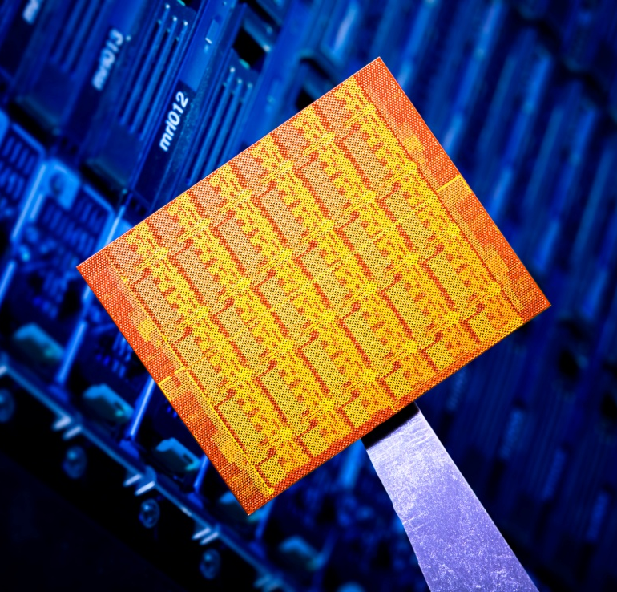
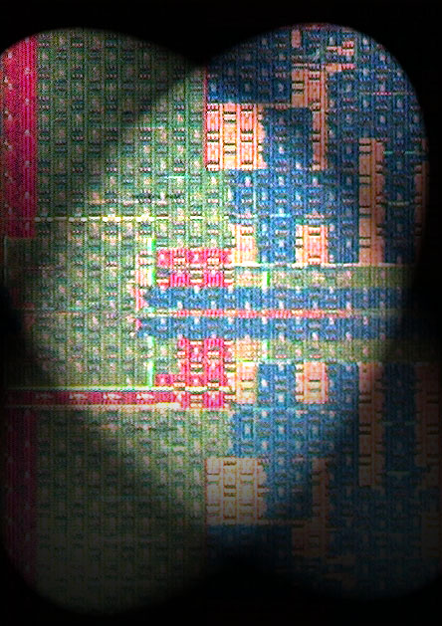
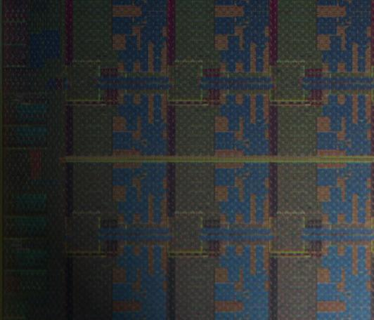
SCC Architecture, a Brief Overview
45nm Hi-K metal-gate silicon
48 IA cores
6x4 2D mesh network
4 DDR3 memory controllers
On-die message buffers
No hardware cache coherency
Dual-core Tile
24 Tiles
24 Routers
48 IA cores
L2 Cache
Core 1
MC
MC
L2$
Core
+
L1$
MC
MC
ROUTER
Message Buffer
ROUTER
1TILE
Core
+
L1$
R
R
R
R
L2$
MEMORY CONTROLLER
L2 Cache
Core 2
R
R
R

Slide 109
Shared Virtual Memory Model
0xFFFFFFFF
VA Private
Shared data
are allocated here
Release Consistency
Model
VA Shared
VA Private
0x00000000
Thread 1
Thread 2
Thread n
Notes:
Each thread has its own virtual memory space.
Part of virtual memory space is shared to store shared data.

Slide 110
Highlights of Our Model
Partial sharing
  Only those actually shared are subjected to consistency maintenance
Release consistency model
  Consistency only guaranteed at the sync points
    Release: make local changes globally visible
    Acquire: update to latest released content
    Significantly reduce coherence traffic
  Many applications already follow RC model
    E.g. sync points: pthread_create, mutex, barrier, …
    Release/Acquire can be inserted automatically at these points
How to implement shared virtual memory and maintain the data coherency?

Slide 111
Scheme 1: DSM (Distributed Shared Memory)
Shared Virtual Memory Space
Core 1
Core 2
Core n
Physical
Memory
Physical
Memory
…
Physical
Memory
Cache
Cache
Cache
On-chip Network
Based on the common TCP/IP stack, ubiquitously available
  Can also be applied to clusters, Windows + Linux, etc.
4 memcpy: user ➔ kernel ➔ NIC PHY ➔ kernel ➔ user
2 user/kernel switches

Slide 112
Optimized Implementation on SCC
Shared Virtual Memory Space
Core 1
Core 2
Core n
Physical
Memory
Physical
Memory
…
Physical
Memory
Cache
Cache
Cache
Shared Physical Memory
Leverage shared physical memory (SPM) support in SCC
Golden copy is saved at SPM, un-cacheable to avoid cache coherency issues
2 memcpy: cacheable private memory ⬄ un-cacheable SPM
No user/kernel switch
However, still OS involved for recording changed content

Slide 113
Scheme 2:
SMCC (Software Managed Cache Coherence)
Shared Virtual Memory Space
Shared Physical Memory
Core 1
Core 2
Core n
Cache
Cache
Cache
…
Priv Physical
Memory
Priv Physical
Memory
Priv Physical
Memory
Directly map shared virtual memory to cacheable SPM
On sync points:
  Acquire: invalidate local cache
  Release: flush changed cache lines
Need hardware support for these cache operations
  L2 cache cannot be invalidated in SCC

Slide 114
Correctness Issue: Lost Update Problem
For write-back cache, lost update when multi-writer write diff parts of the same cache line.
a = 1
release: WBINV
b = 2
release: WBINV
Solution: Write-through
Core 1
Core 2
…
Core n
cache
cache
cache
0
0
0
0
0
0
lost
Shared Physical Memory
0
1
0
1
0
1
2
2
0
114

Slide 115
Protocol Based on Write-through
a = 1
acquire: WBINV
read a
acquire: WBINV
read a
acquire: WBINV
read a
a = 2
Core 1
Core 2
…
Core n
cache
cache
cache
0
0
0
Shared Physical Memory
0
1
1
1
1
2
2
2

Slide 116
Performance Issues and Solutions
L2$ is disabled as L2$ cannot be invalidated
  Set shared pages with MPB Type, thus bypass L2$
  Leave L2$ only to private data, thus no consistence issue
Indiscriminate invalidation thus high $ warm-up time
  Selective invalidation: only invalidate shared data
  A new instruction (CL1MBINV) is added in SCC
    Selective: only invalidate $ lines marked with MPBT
    Fast: only 1 cycle to do the invalidation
High memory bandwidth pressure due to L2$ bypass
  Replicate & privatize RO-shared data (in a computation unit)
  Privatize shared data RW only by one thread
  Take MPB as part of shared memory space

Slide 117
Scalability of Different Protocols
SMCC delivers best scalability

Slide 118
Scalability of SMCC on SCC
  *FFT only support 2^{n} cores.

Slide 119
SW Managed Coherence vs. HW Coherence on a 32way SMP Server
~5% loss
Software managed coherency is as efficient as hardware cache coherency
Notes:
The test setup:
HW - a 32-way SMP server
SW - 32 individual processes on the 32-way SMP server, with “shm” IPC in Linux

Slide 120
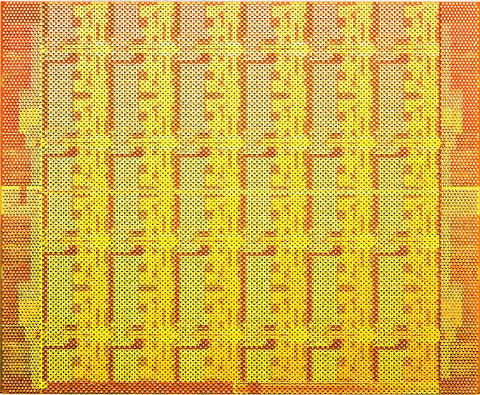
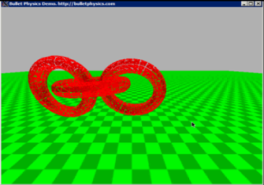
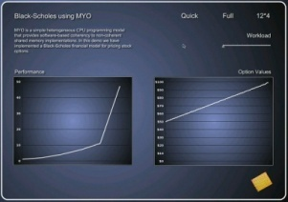
Emerging Usage Models
Separated coherency domains
  Whole system partitioned into multiple coherency domains
  Dynamic reconfigurable
  Mixed mode: share memory in one domain with MPI in others
Domain #1
Domain #3
Non-coherent
MPI-based
Domain #2
Notes:
Already done: 4 independent BlackScholes instances running in 4 domains. Each domain has 12 cores.

Slide 121
Another Usage Model
Multiple SCC chips
  When an application is massively parallel, more SCC chips can be connected together to form a uniform wider coherency domain
A uniform
wider
coherency
domain

Slide 122
Summary
We believe software managed coherency on non-coherent many-core is the future trend
A prototyped partially shared virtual memory system demonstrates it can be:
  Comparable performance vs. hardware coherence
  Adaptive to future advanced usage models
Also opens new research opportunities

Slide 123
Challenges for Future Research
This revived “software managed coherency” topic opens many “cold cases”
What are the right software optimizations?
  Locality, affinity, consistency model
  And more…
What is the right hardware support?
How do emerging workloads adapt to this?
  Our system will be available to SCC community soon.
  Please contact us if you are interested in this topic.

Slide 124
Agenda
09:00 Welcome and Opening Remarks
09:15 Jesse: Keynote Speech
09:45 Jim Held: Keynote Speech
10:45 Break
11:00 SCC Hardware Architecture Overview
11:50 Lunch – Informal discussions & SCC Demo
13:30 Today’s SCC Software Environment
14:10 Message Passing on the SCC
14:50 Software-Managed Coherency
15:30 Break
15:50 Application ”Deep Dive”
16:20 Many-core Applications Research Community
16:40 Experience Sharing
17:10 Q&A
17:30 Adjourn

Slide 125
Agenda
09:00 Welcome and Opening Remarks
09:15 Jesse: Keynote Speech
09:45 Jim Held: Keynote Speech
10:45 Break
11:00 SCC Hardware Architecture Overview
11:50 Lunch – Informal discussions & SCC Demo
13:30 Today’s SCC Software Environment
14:10 Message Passing on the SCC
14:50 Software-Managed Coherency
15:30 Break
15:50 Application ”Deep Dive”
16:20 Many-core Applications Research Community
16:40 Experience Sharing
17:10 Q&A
17:30 Adjourn

Slide 126
JavaScript Farm on SCC
Gansha Wu
Intel Labs China
Intel Labs Single-chip Cloud Computer Symposium December, 2010

Slide 127
ParWeb Project
Today’s web applications
  Becoming more and more sophisticated and complex (productivity suites, photo editing, games, etc.)
  Still largely sequential, despite availability of multi-core and many-core, due to limitations of programming tools and support infrastructure
Project goals
  Flexible and expressive parallel programming model
  Utilize all available resources to maximum

Slide 128
JavaScript
Object-oriented dynamically typed scripting language
Designed for productivity
  One of the most popular web technologies
  One of the most popular scripting languages
Limited support for parallelism
  Web workers (in HTML 5) designed to increase GUI responsiveness
  Web workers can communicate with HTTP servers via message passing

Slide 129
Parallelizing JavaScript on SCC
Offload computation from the client (browser) to the server farm on SCC
Utilize as many off-the-shelf components as possible for high productivity
  Client and server code written in pure JavaScript
  Unmodified client (browser) running on host
  Largely unmodified execution engine (based on Google’s v8) for servers running on SCC
  Standard libraries and tool-chain used on SCC

Slide 130
Web App Architecture
BROWSER
content request
SCRIPTING ENGINE
JS (V8), PHP, …
WEB WORKERS
web
page
JS SCRIPTING ENGINE (v8)
HTTP SERVER
HTTP server’s scripting engine typically used for dynamic web page generation
Can be used for general-purpose computation as well

Slide 131
Single-chip Cloud Computer
BROWSER
content request
SCRIPTING ENGINE
JS (V8), PHP, …
WEB WORKERS
web
page
JS SCRIPTING ENGINE (v8)
HTTP SERVER
PCIe
SCC

Slide 132
Enabling SCC
BROWSER
content request
SCRIPTING ENGINE
JS (V8), PHP, …
WEB WORKERS
web
page
JS SCRIPTING ENGINE (v8)
HTTP SERVER
compute request
compute response
PCIe
SCRIPTING ENGINE
JS (V8), PHP, …
HTTP SERVER
SCC

Slide 133
Web Workers ➔ Actors
BROWSER
content request
SCRIPTING ENGINE
JS (V8), PHP, …
ACTORS
web
page
JS SCRIPTING ENGINE (v8)
HTTP SERVER
compute request
compute response
PCIe
SCRIPTING ENGINE
JS (V8), PHP, …
ACTORS
HTTP SERVER
SCC

Slide 134
Compute Servers
BROWSER
content request
SCRIPTING ENGINE
JS (V8), PHP, …
ACTORS
web
page
JS SCRIPTING ENGINE (v8)
HTTP SERVER
compute request
compute response
PCIe
JS SCRIPTING ENGINE (v8)
ACTORS
COMPUTE SERVER
SCC

Slide 135
Infrastructure
Actors on both sides programmed in JavaScript
Support for compute servers
  Google’s v8 JavaScript execution engine at the core
  v8cgi wrapper around v8 for standalone execution environment (minor modifications)
Unmodified browser can only “talk” HTTP
  Custom communication layer for compute servers written in JavaScript
  Problem with “single-origin policy”

Slide 136
Single-origin Policy
A script downloaded from a server can only exchange messages with that single server
Except…
  A script can run in global scope or in “iframe”
  Multiple iframes created by the same program can be downloaded from different servers
  Variables and function definitions can be shared between global scope and iframes
Solution – generic iframes downloaded from compute servers and used to bootstrap computation defined in global scope

Slide 137
Case Studies
Parallel ray-tracer (presented here) and parallel physics engine
Identical infrastructure
Parallel ray-tracer based on sequential JavaScript app from Google’s JavaScript v8 benchmark suite
Two different approaches for work distribution
  Dispatcher
  Direct

Slide 138
Dispatcher Approach
Reduce host/device network traffic
Utilize 8 cores (for simplicity):
  Dispatcher actor on core 0
  Worker actors on the remaining 7 cores
  Dispatcher talks to browser and deals work
  Workers perform actual computation
BROWSER
ACTORS
JS SCRIPTING ENGINE (v8)
PCIe
SCC

Slide 139
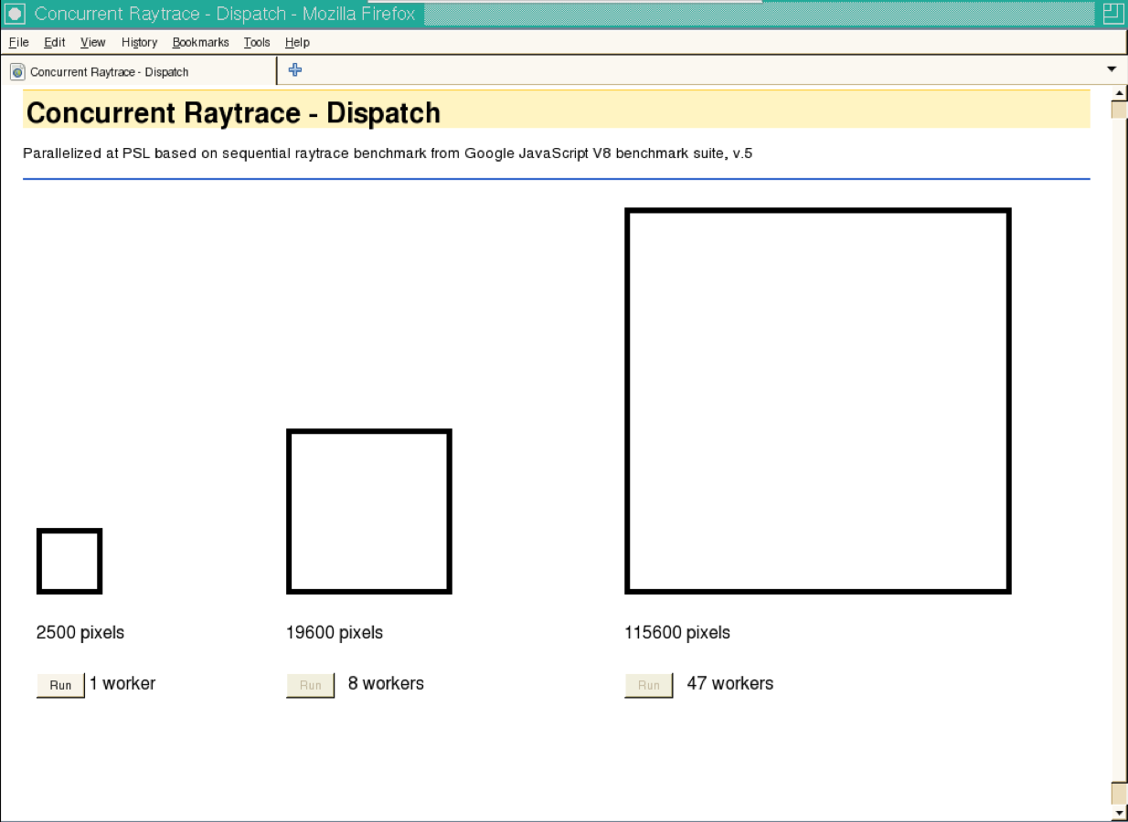
Browser Front End

Slide 140
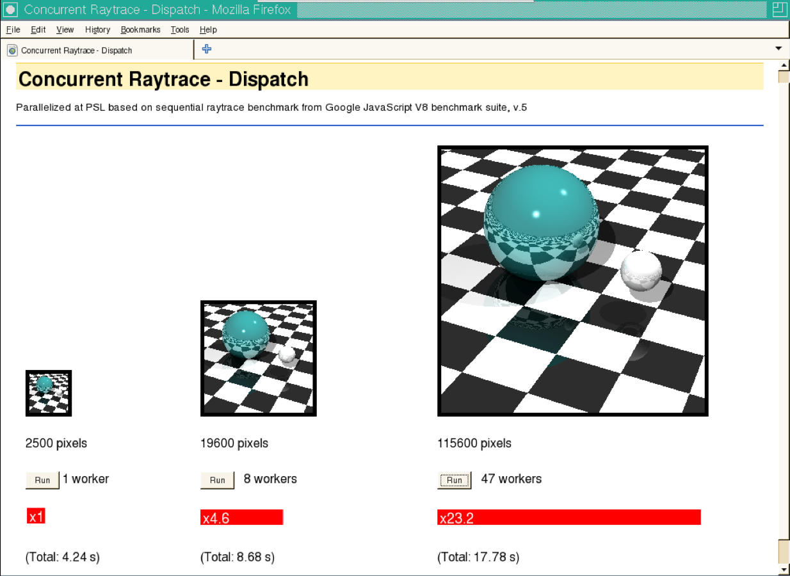
Dispatcher Results

Slide 141
Direct Approach
Assume host/device traffic is a non-issue
Again, utilize 8 cores
(for simplicity):
  Worker actors on all 8 cores
  Workers talk to browser and perform actual computation
BROWSER
ACTORS
JS SCRIPTING ENGINE (v8)
PCIe
SCC

Slide 142

Direct Results
(DISPATCH)

Slide 143
Direct Results
(DISPATCH)

Slide 144
Results Summary
Actor distribution does make a difference
Both approaches yield similar scalability for large pictures – ~50%
Host/device network effortlessly handles 48 independent connections
  Direct approach is ~2x faster than dispatcher approach
  Multiple worker sending rendered image piece-wise help hiding communication latency

Slide 145
Conclusions
Prototyped a server farm on SCC
Infrastructure utilizes mostly off-the-shelf software components and tools
Demonstrated good scalability
Future work includes
  Better implementation of the communication layer in a plug-in (no iframes!)
  Experimentation with other applications that exercise the actor model (e.g. inter-actor communication and collaboration)

Slide 146
Agenda
09:00 Welcome and Opening Remarks
09:15 Jesse: Keynote Speech
09:45 Jim Held: Keynote Speech
10:45 Break
11:00 SCC Hardware Architecture Overview
11:50 Lunch – Informal discussions & SCC Demo
13:30 Today’s SCC Software Environment
14:10 Message Passing on the SCC
14:50 Software-Managed Coherency
15:30 Break
15:50 Application ”Deep Dive”
16:20 Many-core Applications Research Community
16:40 Experience Sharing
17:10 Q&A
17:30 Adjourn

Slide 147
Many-core Applications Research Community (MARC)
Jim Held
Fellow, Intel Labs
Intel Labs MARC Symposium
December 9, 2010

Slide 148
MARC
Developing a Community of Researchers
  Altreonic, Barcelona Supercomputing Center, ET International, ETH Zurich, Florida International University, FORTH-ICS (University of Crete), Galicia Supercomputing Center (CESGA), Georgia Tech University, Hasso-Plattner-Institute, Karlsruhe Institute of Technology (KIT), Lessius-Mechelen - Campus De Nayer, Mercury Computer Systems, ONERA, Purdue University, Reservoir Labs, Rutgers University, RWTH Aachen University, Sabanci University, Seoul National University, Stanford University, SUNY Binghamton, Swiss Federal Institute Zurich, Texas A&M University, Tsinghua University, Technical University Berlin, Technical University Braunschweig, Technical University Cottbus, Turku University, University of California – Irvine, UNICAMP, University of Amsterdam, University of Auckland New Zealand, University of Bayreuth, University of Bologna, University of Cambridge, University of Cyprus, University of Edinburgh, University of Erlangen, University of Glasgow, University of Hertfordshire, University of Illinois Urbana Champaign, University of Innsbruck, University of Michigan Ann Arbor, University of Missouri Kansas City, University of Oxford, University of Paderborn, University of Potsdam, University of Texas Austin, University of Toronto, University of Vienna, Vrije Universiteit, and many others
Worldwide research partnership program with academia & industry
Providing access to SCC for many-core programming research
Overwhelming interest
  Over 400 inquiries and requests for more information
  Over 200 proposals received
  130+ proposals were accepted
Participants from around the world
  40% Europe, 40% US, 20% Rest of World
  Leading research institutions and companies

Slide 149
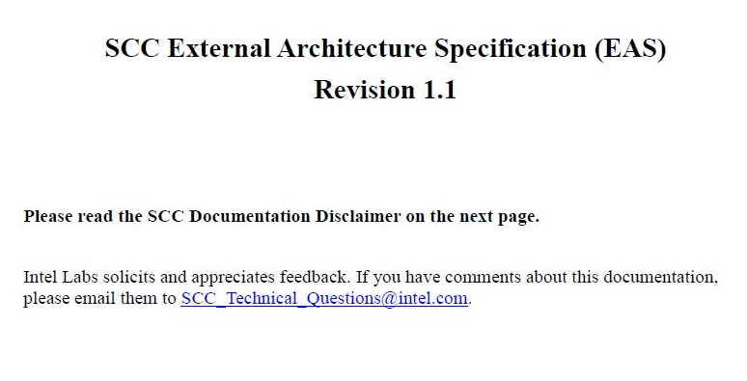
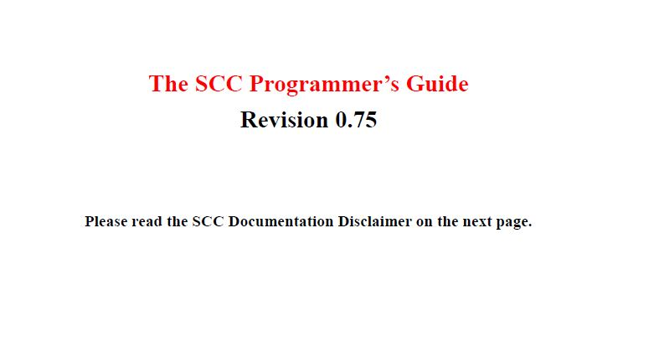
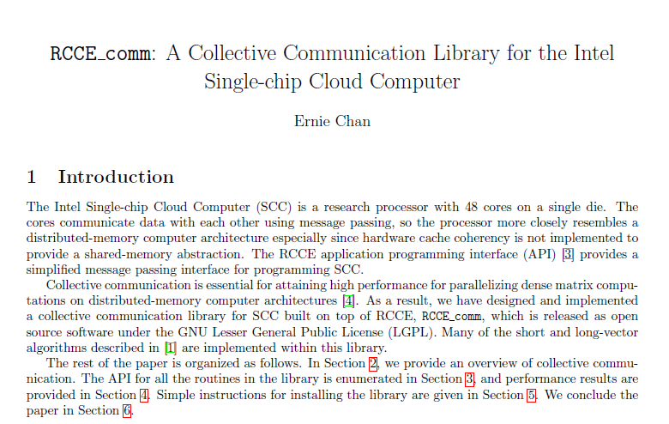
MARC
Starter Package for Participants
Access to an SCC System: Remote access or at your site – depending on your research needs
Documentation: SCC Architecture, How To Guides, RCCE Messaging Library Spec, SCC APIs, more
Open Source SW: Sample Linux image for SCC, RCCE Messaging Library sources, all SCC Intel and Community Contributed S/W
Tools: Intel C Compiler, Trace Analyzer. Math Libraries (MKL) and Intel Fortran are available by special request.
Support: Limited support on Intel S/W. Self-Supporting w/in the community. Full Support on all H/W issues.

Slide 150
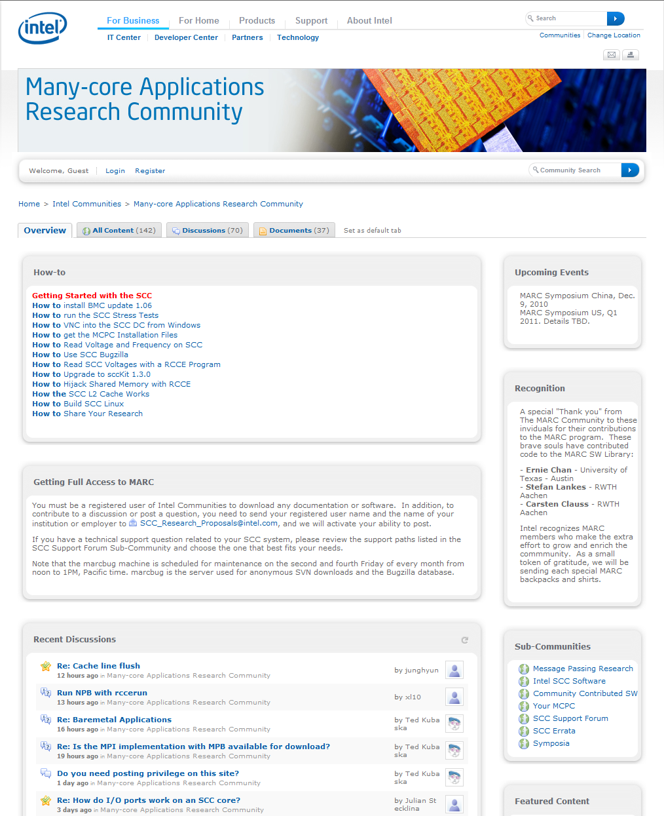
MARC
Website for Community Researchers
Documentation on all Intel SCC S/W and H/W
Full sources – all Intel SCC S/W is provided Open Source
User-contributed software is strongly encouraged
Monitored discussion pages
Shared ideas to help overcome research problems
Peer assistance on “How To” issues, design research plans
Intel encourages Forum/Topic Sponsors
http://communities.intel.com/community/marc

Slide 151
MARC
Community Development
Regular Intel Sponsored Conferences
  Chance to present Data, discuss Results
Frequent SCC Special Topic Workshops
  Memory, Power Mgmt, Languages, etc
  Face to Face and/or Webinars
  Community driven, not just Intel taking lead
Opportunities to network, find research partners through our events and website

Slide 152
MARC
Research Proposal Process
Submit a proposal to Intel
  SCC Research Proposal Template Available on our website http://communities.intel.com/docs/DOC-5076
Selection Criteria
  Will it help Intel build better Hardware?
  Will it advance the development of parallel programs for cloud and client?
  Details to be provided on the application forms
If selected, we will need a signed Material Transfer Agreement (MTA) Contract
  Rules for accessing your SCC system
  Clear understanding of Intellectual Property rights, protecting you and Intel

Slide 153
SCC Program In China
Harvest on Huawei and Tsinghua’s SCC research
Call for participation and look forward to
  More Chinese friends in MARC
  Broader range of SCC access in China
  New research activities on SCC
ICCPC plays a more important role
  China-wide technical support
  SCC data center online hosting

Slide 154
Questions?
General Questions or to request an Application
  SCC_Research_Proposals@intel.com
Technical Questions re: SCC Platform, Research
SCC_Support_USA@intel.com

Slide 155
Agenda
09:00 Welcome and Opening Remarks
09:15 Jesse: Keynote Speech
09:45 Jim Held: Keynote Speech
10:45 Break
11:00 SCC Hardware Architecture Overview
11:50 Lunch – Informal discussions & SCC Demo
13:30 Today’s SCC Software Environment
14:10 Message Passing on the SCC
14:50 Software-Managed Coherency
15:30 Break
15:50 Application ”Deep Dive”
16:20 Many-core Applications Research Community
16:40 Experience Sharing
17:10 Q&A
17:30 Adjourn

Slide 156
Agenda
09:00 Welcome and Opening Remarks
09:15 Jesse: Keynote Speech
09:45 Jim Held: Keynote Speech
10:45 Break
11:00 SCC Hardware Architecture Overview
11:50 Lunch – Informal discussions & SCC Demo
13:30 Today’s SCC Software Environment
14:10 Message Passing on the SCC
14:50 Software-Managed Coherency
15:30 Break
15:50 Application ”Deep Dive”
16:20 Many-core Applications Research Community
16:40 Experience Sharing
17:10 Q&A
17:30 Adjourn

Slide 157
Agenda
09:00 Welcome and Opening Remarks
09:15 Jesse: Keynote Speech
09:45 Jim Held: Keynote Speech
10:45 Break
11:00 SCC Hardware Architecture Overview
11:50 Lunch – Informal discussions & SCC Demo
13:30 Today’s SCC Software Environment
14:10 Message Passing on the SCC
14:50 Software-Managed Coherency
15:30 Break
15:50 Application ”Deep Dive”
16:20 Many-core Applications Research Community
16:40 Experience Sharing
17:10 Q&A
17:30 Adjourn

